Slide 1


BREAKING WIND
WIND FARM CHALLENGE by Anemo Analytics

Slide 2




TODAY
24%
76%

Slide 3
HOW RENEWABLE CAN WE GO ?
100%

Slide 4

PROBLEM
REAL-TIME FARM SETUP
MAINTENANCE PLAN
SALES
VOLUMES

Slide 5


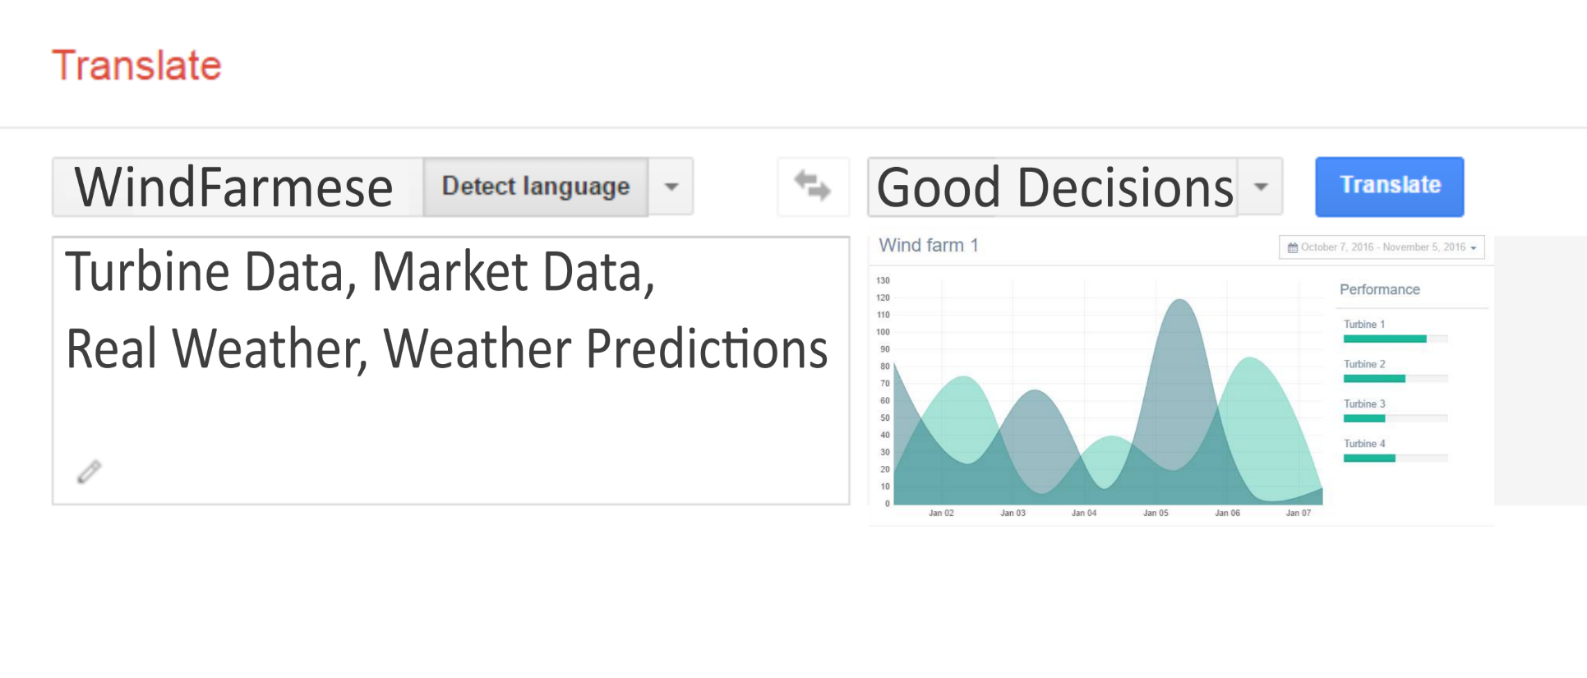
SOLUTION
INCREASE IN PRODUCTION
SAVING ON MAINTENANCE
INCREASE IN SALES

Slide 6

PRODUCT
MONITORING
PREDICTIONS
MAINTENANCE
MARKET

Slide 7

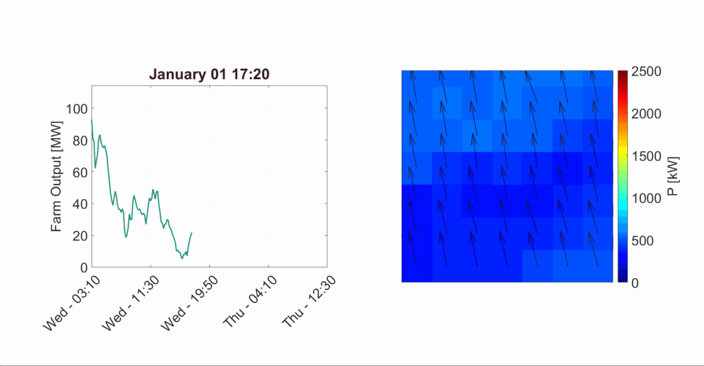
MONITORING
PREDICTIONS
REAL-TIME MONITORING
MAINTENANCE
MARKET
WIND FARM POWER LAYOUT

Slide 8

MONITORING
PREDICTIONS
REAL-TIME MONITORING
MAINTENANCE
MARKET

Slide 9
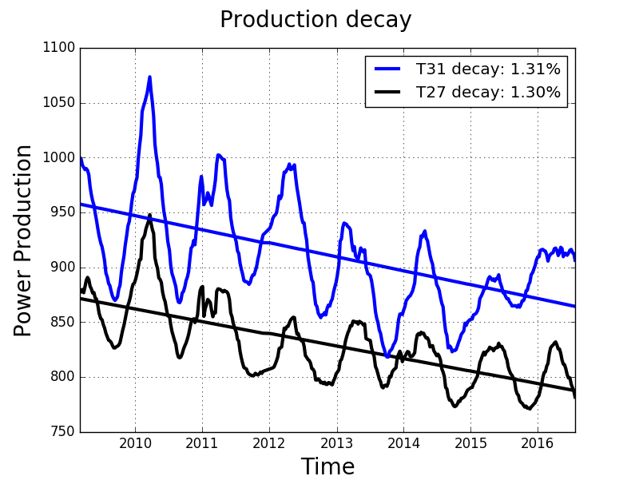
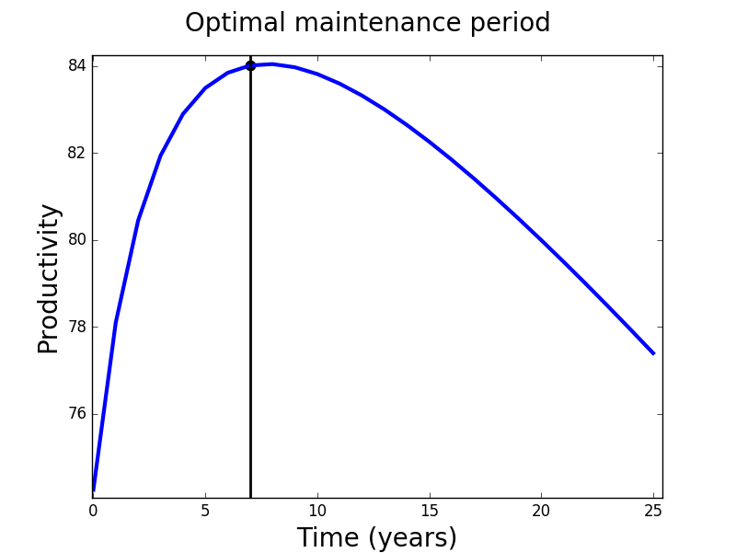
MONITORING
PREDICTIONS
MAINTENANCE
MAINTENANCE
MARKET
PRODUCTION DECAY
OPTIMAL MAINTENANCE PERIOD

Slide 10
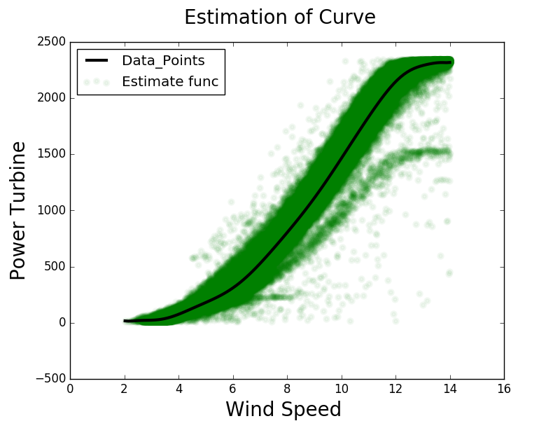
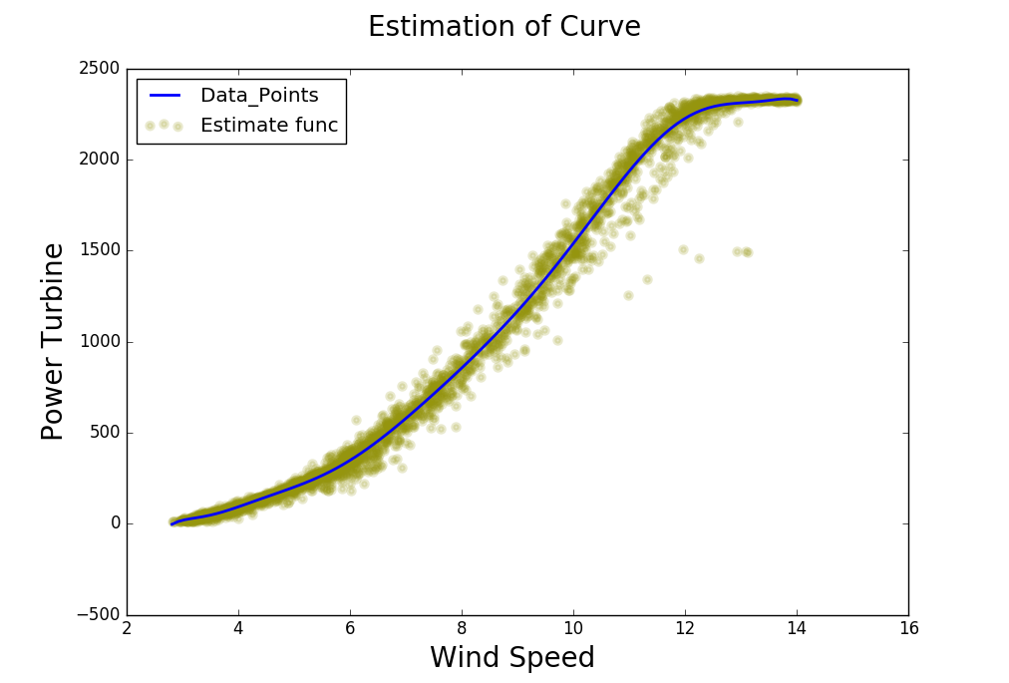
MONITORING
PREDICTIONS
ACCURATE PREDICTIONS
MAINTENANCE
MARKET
NAIVE MODEL
OUR MODEL

Slide 11
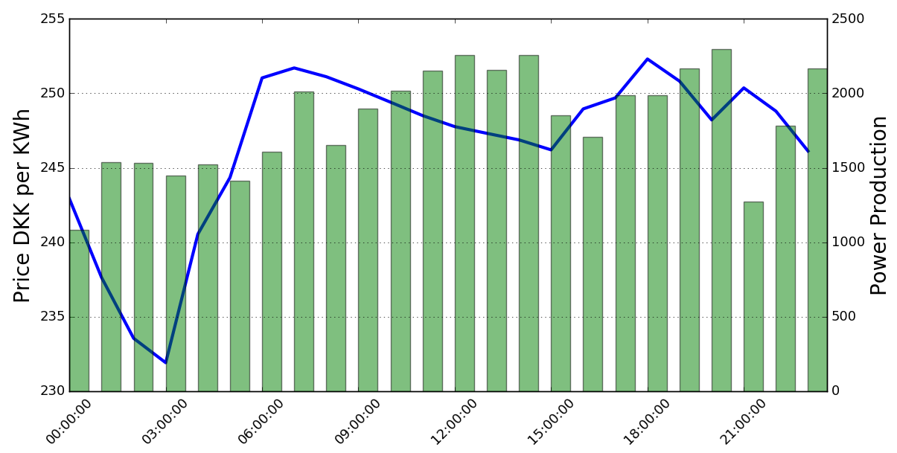
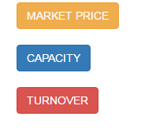
MONITORING
PREDICTION
MARKET CONNECTION
MAINTENANCE
MARKET

Slide 12



FARM OPERATOR
BUSINESS MODEL
SERVICE SUBSCRIPTION
WEB APP
DATA
COLLECTION
MARKET
WEATHER
WIND FARM

Slide 13
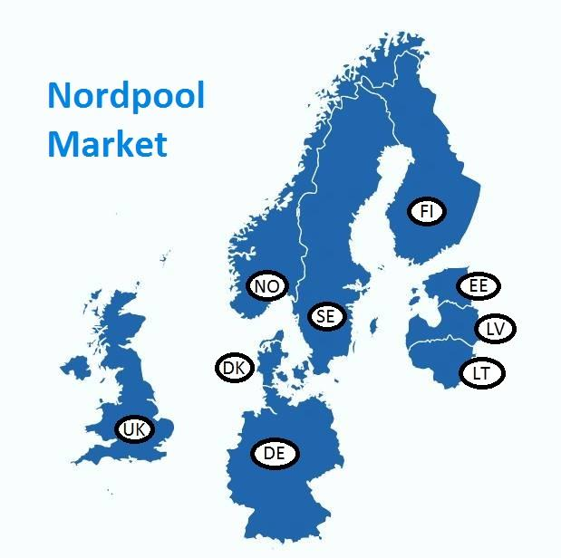

MARKET
489 TWh TRADED IN 2015
~10 BILLION € TURNOVER
>14% WIND ENERGY
NORDPOOL MARKET

Slide 14




TEAM
SMART ONE
Combined
20 Years of Work Experience
3 Mechanical
1 Electrical and
1 Management Engineer
Specialising
In
Machine Learning

Slide 15
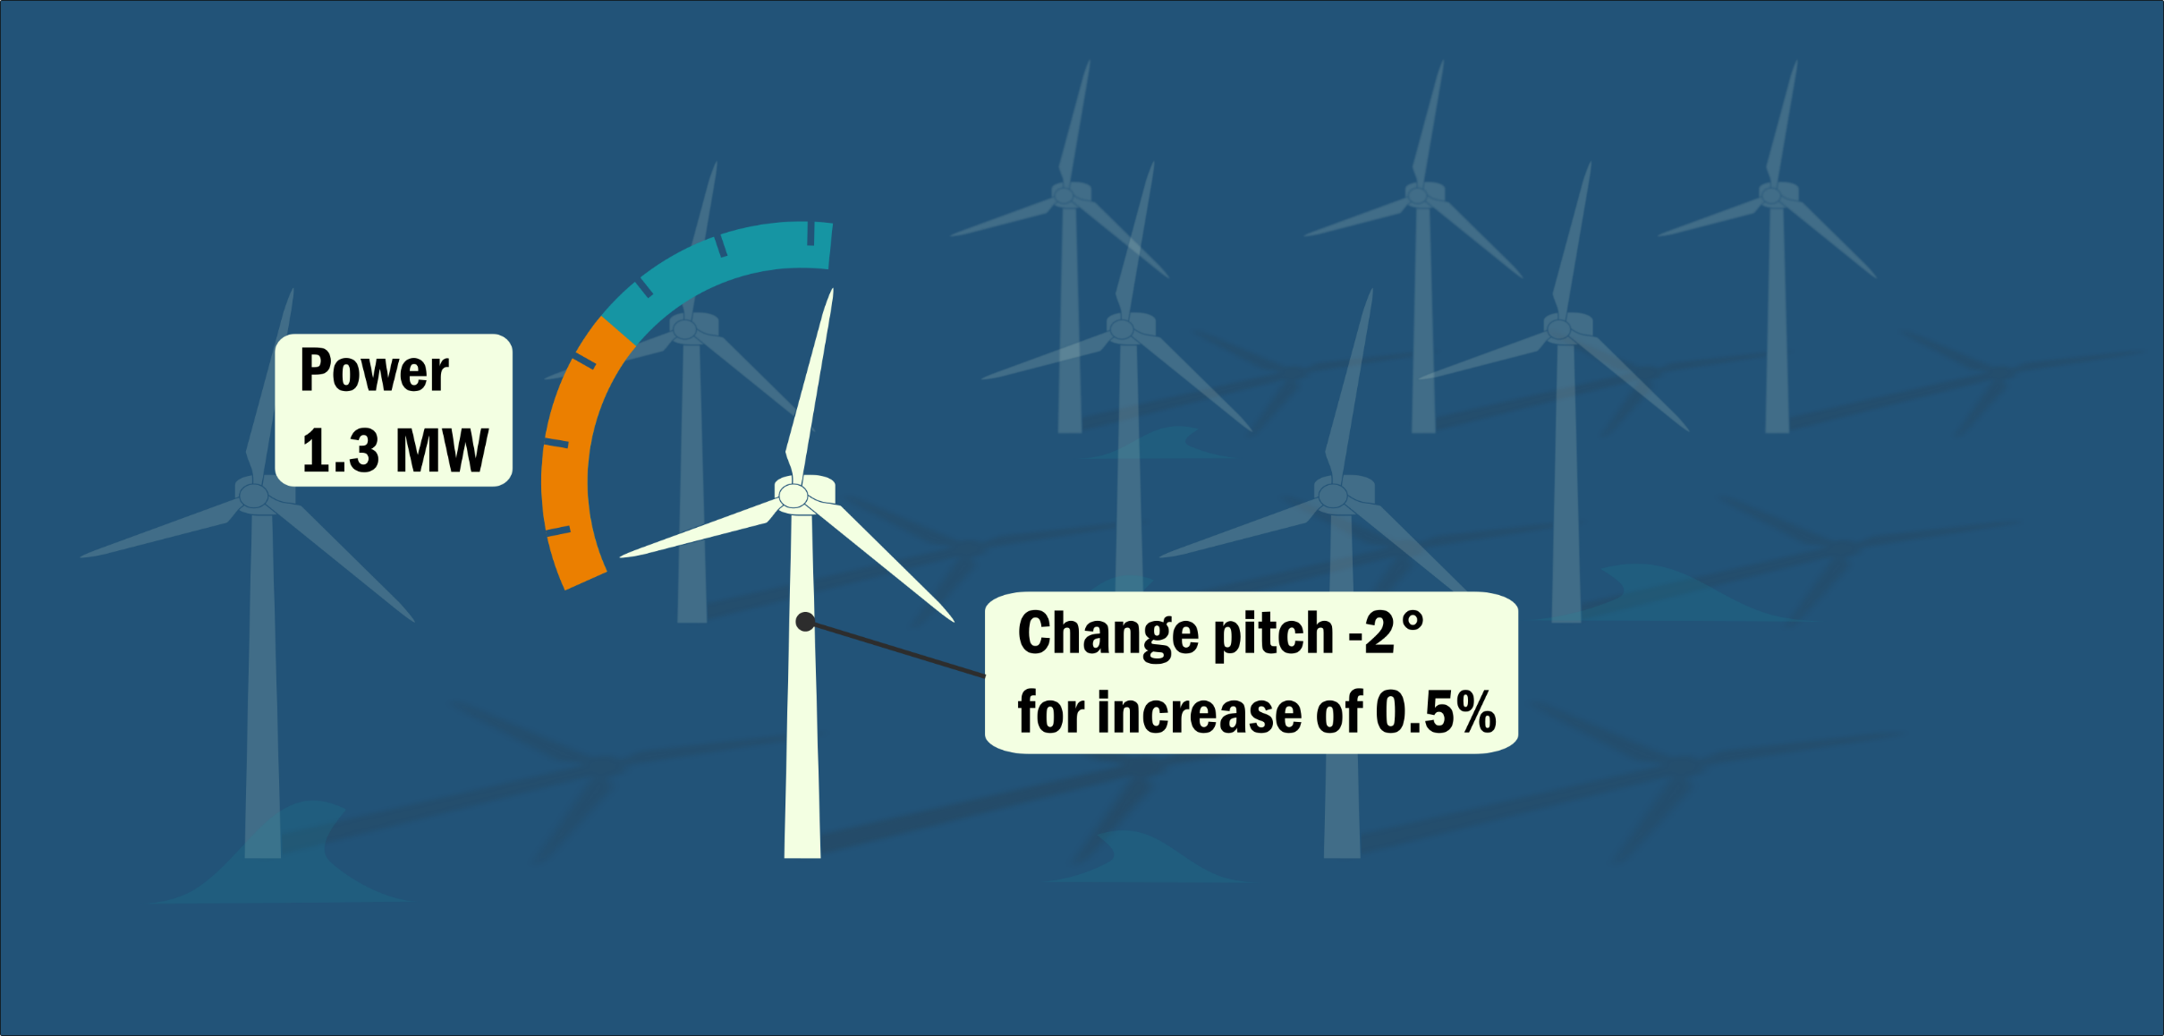

Real-time monitoring

